Slide 1
FITFUSION: FITNESS TRACKING SYSTEM
Submitted By:
KK Shyaam(230701313)
P SriVignesh(230701339)
LYashwanth(230701387 )
R Subamalai
Asst.professor
CSE

Slide 2
1.INTRODUCTION
In order to make these digital experiences truly reflect varied user expectations, the use of design thinking has emerged as a strong weapon in contemporary app development.this project report documents the creation of fit fusion — an interactive, user-focused fitness app designed to provide personalized workout routines and diet plans based on users’ height, weight, age, and fitness objectives.The traditional approaches to fitness and diet planning are undergoing a significant transformation through technology. Where once individuals relied on personal trainers and paper-based methods, digital platforms now offer customized fitness routines and dietary guidance tailored to each user's specific needs.

Slide 3
Problem Statement
Many fitness enthusiasts struggle to track their workout progress effectively. Existing tools either lack personalization or overwhelm users with complex data, leading to inconsistent progress and diminished motivation.
Fitness platforms frequently fail to sustain user engagement over time, resulting in high dropout rates and unmet fitness goals. There’s a need for dynamic, interactive features to keep users motivated and accountable

Slide 4
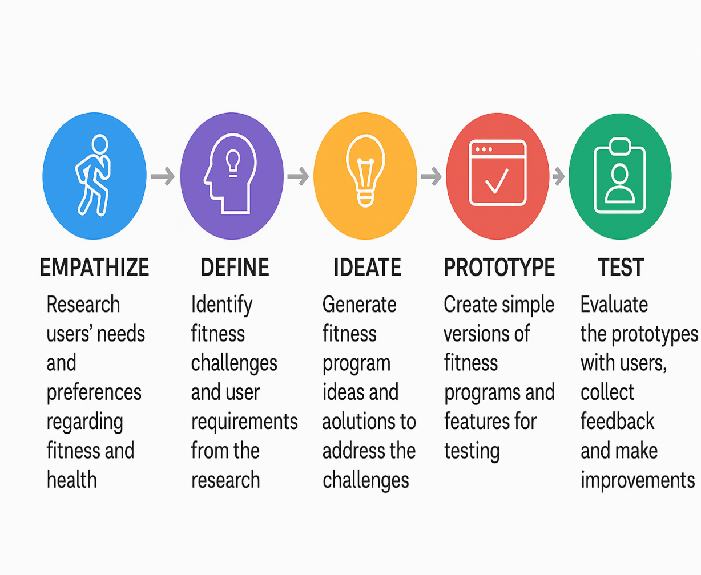
STANFORD DESIGN THINKING MODEL
1.Empathize : gain a deep understanding of the health issues, fitness objectives,and lifestyle obstacles of usrs.
2.Define : summarize the empathy insights into practical problem statements.
3.Ideate : produce a broad set of innovative solutions to address fitness and nutrition issues.
4.Prototype : create low-fidelity models (wireframes, clickable app demos) to conceptualize how users would interact with fit fusion.
5.Test : test the prototype with actual users, collect feedback, and iterate.

Slide 5
Features of the Project
1. AI-Driven Personalized Plans
Uses machine learning to dynamically adjust workouts and diet plans based on user progress, preferences, and even mood.
Integrates real-time feedback from wearable devices to customize workout difficulty and nutrition advice.
2.Smart Meal Planning
Provides AI-generated personalized meal plans, including recipes based on available ingredients at home.
3.Adaptive Micro-Workouts
Suggests short, adaptive workouts based on the user’s free time and
energy level.
4.Mental Fitness & Motivation Tools
Provides mindfulness and mental fitness modules (e.g., guided meditation, affirmations).

Slide 6
Pain points Identified
1.Supabase Dependency and Backend Limitations
Single Point of Failure: Heavy reliance on Supabase for backend services If Supabase faces issues or the plan hits limits, core app functionalities could break.
2.Scalability Challenges
Real-Time Data Load: Handling multiple simultaneous users and syncing real-time data could be challenging.
3.Feature Complexity & Overload
The project includes many advanced features.If not streamlined properly, it may overwhelm users, especially beginners.
4.UI/UX Optimization
Ensuring the app looks great and functions well across all devices (desktop, tablet, mobile) can be tricky.

Slide 7
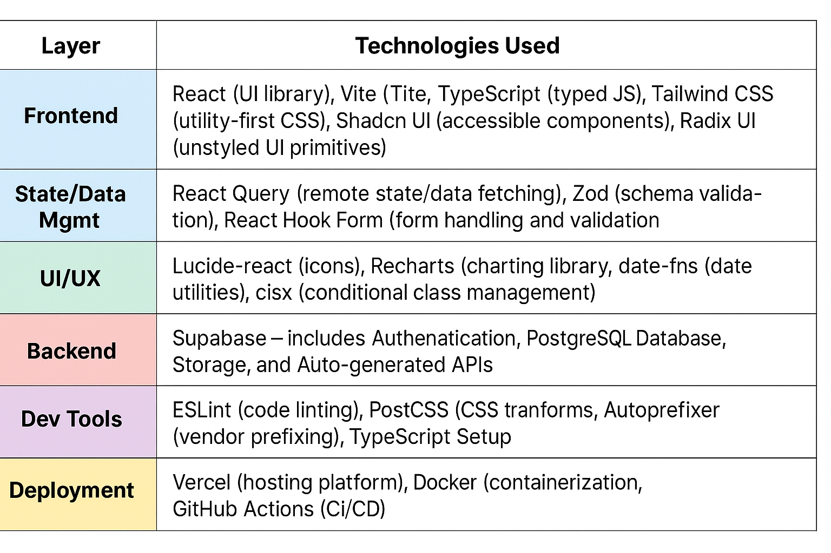
Technologies Used

Slide 8
Comparative Analysis of Existing system
DISADVANTAGES | CHANGES WE MADE TO RECTIFY THE DISADVANTAGES
Time-Consuming: Collecting, analyzing, and comparing multiple systems can take significant time and resources. | To avoid wasting time, I limited my analysis to the most relevant and popular fitness apps that shared similar goals with mine. This helped me focus only on systems that could offer meaningful insights for my project.
Subjectivity: The analysis may be biased depending on the criteria chosen or the evaluator's preferences. | I addressed bias by setting clear, objective criteria for comparison. These included personalization features, UI/UX quality, the variety of plans offered, and user engagement tools. This made the comparison more structured and less opinion- based.
Incomplete Information: Some systems may have proprietary features or undocumented limitations, making comparisons inaccurate. | Since not all app features are documented publicly, I personally tested several fitness apps and also referred to user reviews and feedback. This allowed me to uncover practical limitations and hidden strengths that wouldn’t be found through surface-level research.

Slide 9
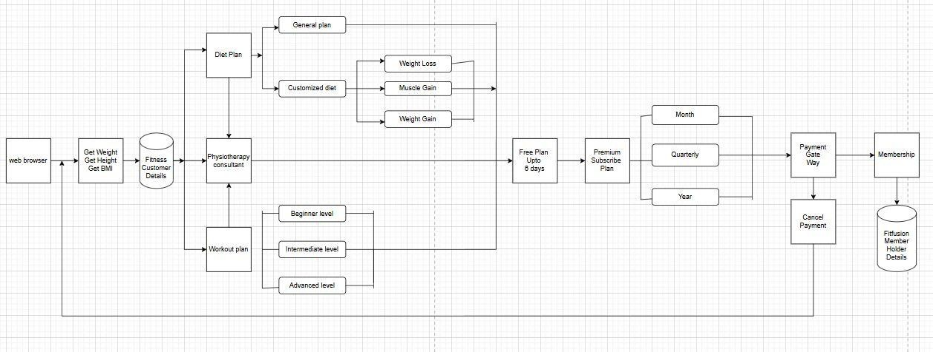
Proposed Method (Design Thinking Approach)
OVERVIEW OF ARCHITECTURE DIAGRAM:
The user interacts with the system through a web browser, entering basic health data such as weight and height.
The system automatically calculates the BMI and stores all inputs under Fitness Customer Details.
This information is further processed to create personalized workout and diet plans, incorporating real-time data
The system leverages Supabase for secure backend storage and rapid data retrieval to support user experiences.

Slide 10
Based on the input, the app generates personalized recommendations for:
Diet Plans:
Includes a General Plan and a Customized Diet.
Customized Diet is tailored for goals like Weight Loss, Muscle Gain, or Weight Gain.
Workout Plans:
Categorized by fitness level: Beginner, Intermediate, or Advanced.
A Physiotherapy Consultant is available to assist users who need professional or medical guidance.
New users can access a Free Plan for up to 8 days.
After the free period, users can choose a Premium Subscription Plan with options for:
Monthly
Quarterly
Yearly billing.
Payments are processed through a secure Payment Gateway, with an option to cancel if needed.
Upon successful payment, users gain Membership, and their information is stored in the FitFusion Member Holder Details database.
This system ensures a customized, flexible, and professional fitness experience tailored to each user’s needs.

Slide 11
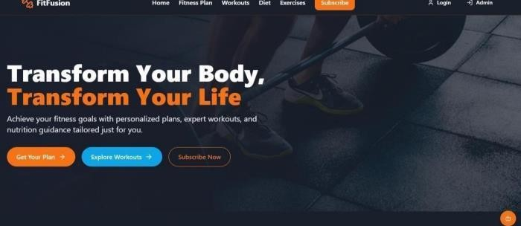
Proposed Method (Implementation /Prototype Developed)
FitFusion Homepage UI:
The navigation bar at the top provides quick access to main features such as Home, Fitness Plan, Workouts, Diet, and
Exercises, along with Login, Admin, and Subscribe options for different user roles. Three prominent call-to-action
buttons—Get Your Plan, Explore Workouts, and Subscribe Now—encourage user interaction and guide them toward key app functionalities. The visual of a person lifting a barbell in the background emphasizes strength, dedication, and progress, aligning well with the app’s mission.

Slide 12
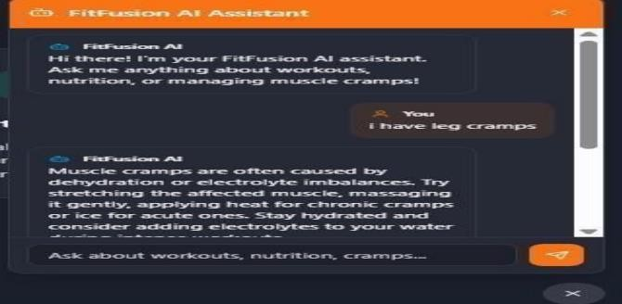
FitFusion AI Assistant – Chat Interface Overview
A built-in intelligent chatbot designed to guide users in real-time.The assistant welcomes users with a friendly message, encouraging them to ask about workouts, nutrition, or managing common issues such as muscle cramps.
The assistant explains that muscle cramps are often caused by dehydration or electrolyte imbalances and suggests
practical remedies such as stretching, gentle massage, applying heat or ice, and staying hydrated with added
electrolytes.
The intuitive chat layout, complete with scrollable history and a message input area with a send button, reflects a user-friendly, modern interface that integrates seamlessly into the app’s overall design.

Slide 13
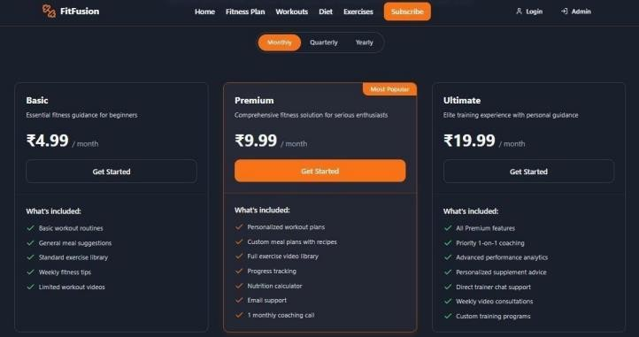
FitFusion Subscription Plans Overview:
Choose from three flexible plans tailored to your fitness level and goals:
Basic (₹4.99/mo): Ideal for beginners. Includes basic workouts, general meal suggestions, exercise library, fitness tips, and limited videos.
Premium (₹9.99/mo): Most popular. Adds personalized workout & meal plans, full video library, progress tracking, nutrition calculator, email support, and 1 coaching call/month.
Ultimate (₹19.99/mo): For serious users. Includes all Premium features plus 1-on-1 coaching, performance analytics, supplement advice, trainer chat, weekly consultations, and custom training.
Plans adapt based on your weight, age, height, and goals. Available Monthly, Quarterly, or Yearly.

Slide 14
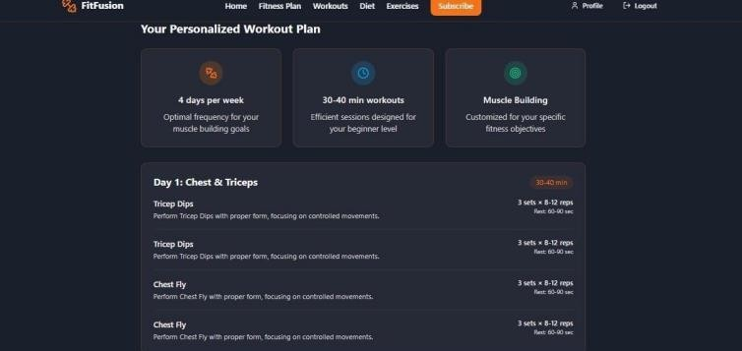
Personalized Workout Plan – FitFusion
Your customized fitness routine is designed for muscle building with:
4 days/week frequency
30–40 min sessions optimized for beginners
Focus on muscle development tailored to your body profile

Slide 15
Target Audience Benefitted
1.Fitness Enthusiasts
People already engaged in fitness routines who want advanced tracking, personalized plans, and detailed insights into their progress.
2.Beginners & Casual Users
Those just starting their fitness journey, needing easy-to-follow plans, reminders, and guided tutorials.
3.Community-Oriented Users
Fitness enthusiasts who enjoy connecting with friends, sharing progress, and participating in group challenges
4.Holistic Wellness Seekers
Those focusing not just on physical fitness but also on mental well-being, mindfulness, and sustainability.

Slide 16
Conclusion
FitFusion redefines personalized fitness by combining modern technology with a user centered approach. By leveraging the Stanford Design Thinking model, we’ve developed a platform that addresses the specific needs of fitness beginners, enthusiasts, and professionals alike. Through features like AI-driven workout and diet plans, adaptive micro- workouts, and smart meal suggestions, FitFusion offers a holistic and flexible solution for achieving health goals. While backend dependencies and feature complexity present challenges, our thoughtful design and iterative testing help mitigate these risks.
Overall, FitFusion stands as a scalable and innovative fitness solution
tailored to today’s dynamic user expectations.

